Slide 1


F
FUZIO PROPERTIES
MeterCapture
A field-to-office platform for capturing, cleaning and auditing every
meter reading across the portfolio.
Concept Pitch
Prepared by Nate · 20 July 2026

Slide 2




F
The problem
Meter reading is still a paper-and-inbox process
The pain points this project sets out to fix, across every building Fuzio manages.
Manual reading sheets
No single source of truth
Some buildings send in paper reading sheets — the on-site operator never visits, so there's no photo evidence or standard format to work from.
Readings and photos live scattered across spreadsheets, inboxes and phone camera rolls, with no consistent way to find one.
Disputes are hard to defend
Untracked data entry
When an owner appeals a usage charge, finding the original photo and reading behind it means a manual search through folders.
Manual transcription introduces errors, and there's no flagging when a reading jumps implausibly from the month before.
Fuzio MeterCapture — Concept Pitch
2

Slide 3




F
The solution
One flow: field to office, automatically
1
2
3
4
5
Select building
Capture & label
Clean & validate
Register & archive
Audit trail
Operator picks the building or client from their assigned list.
Every meter photographed, read and tagged, one after another.
Pipeline checks each reading, flagging anomalies for review.
Stored in the Excel register, with photos indexed alongside.
Every capture, edit and export logged for full traceability.
This deck walks through the mobile capture app, the admin back office, and where the AI assistant fits in later.
Fuzio MeterCapture — Concept Pitch
3

Slide 4
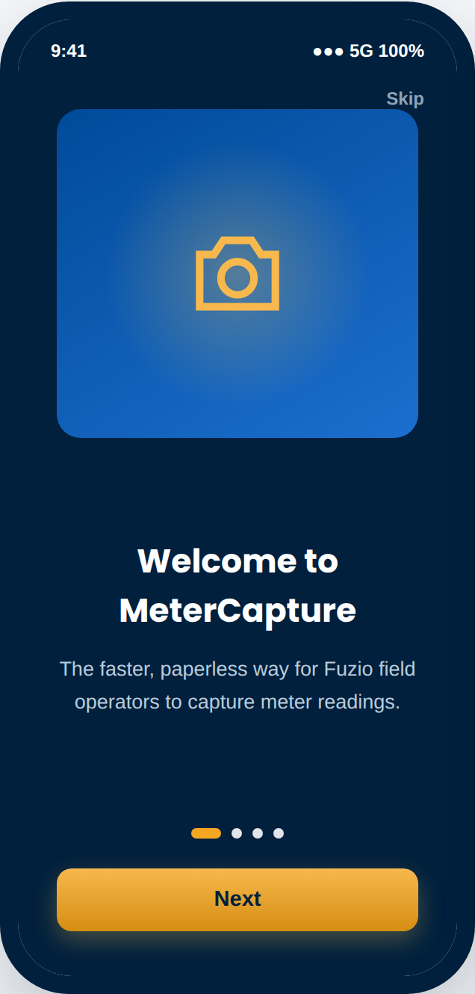
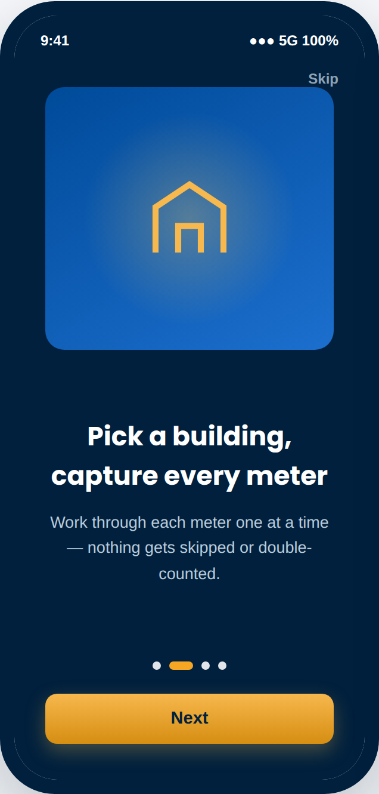
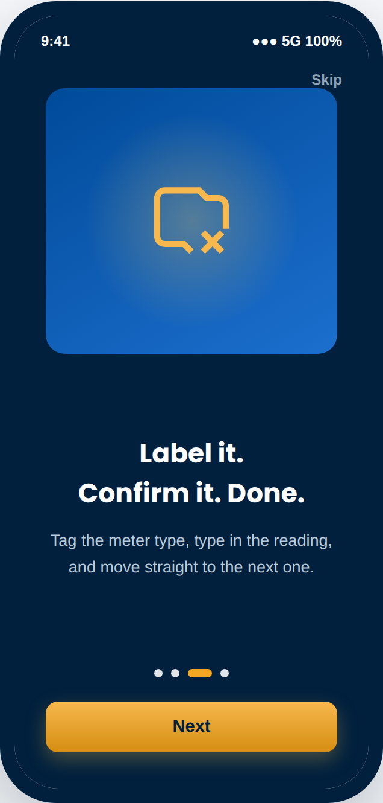
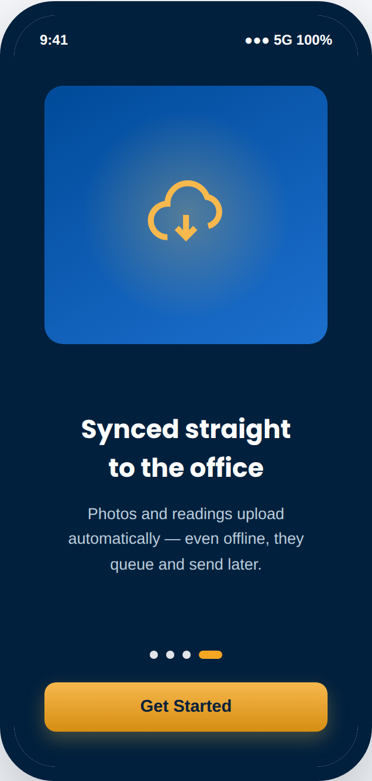
F
Mobile app
A tutorial, from the first launch
Four short screens set expectations before an operator ever opens the camera — and it's always one tap away again from Settings.
Fuzio MeterCapture — Concept Pitch
4
1. Welcome
2. Select & shoot
3. Label & confirm
4. Sync & go

Slide 5
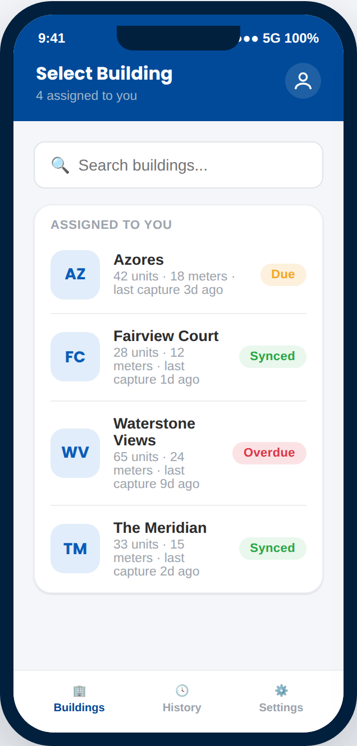
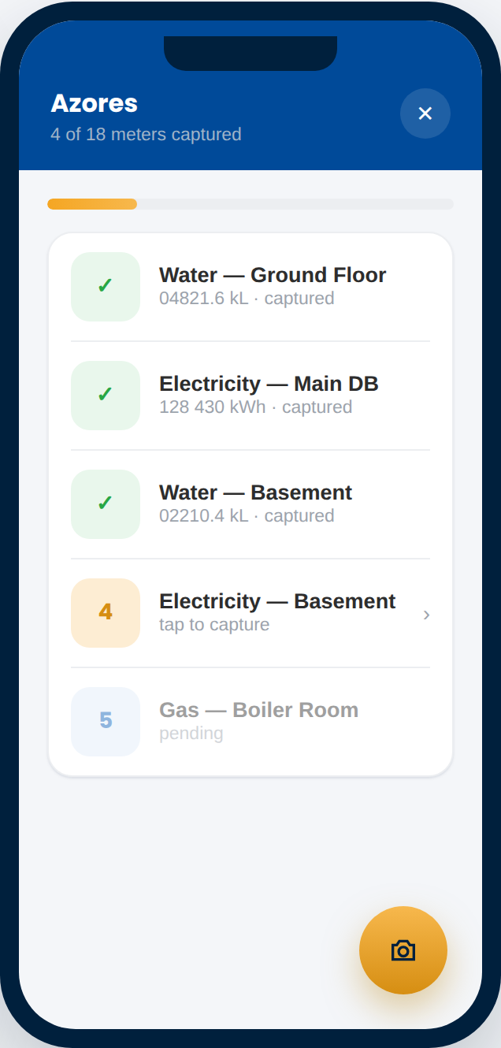
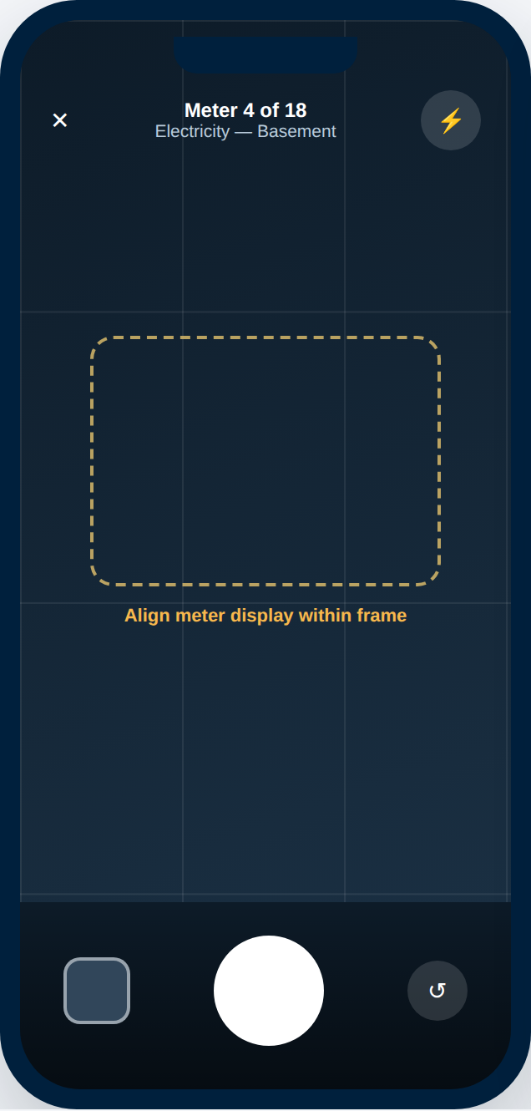
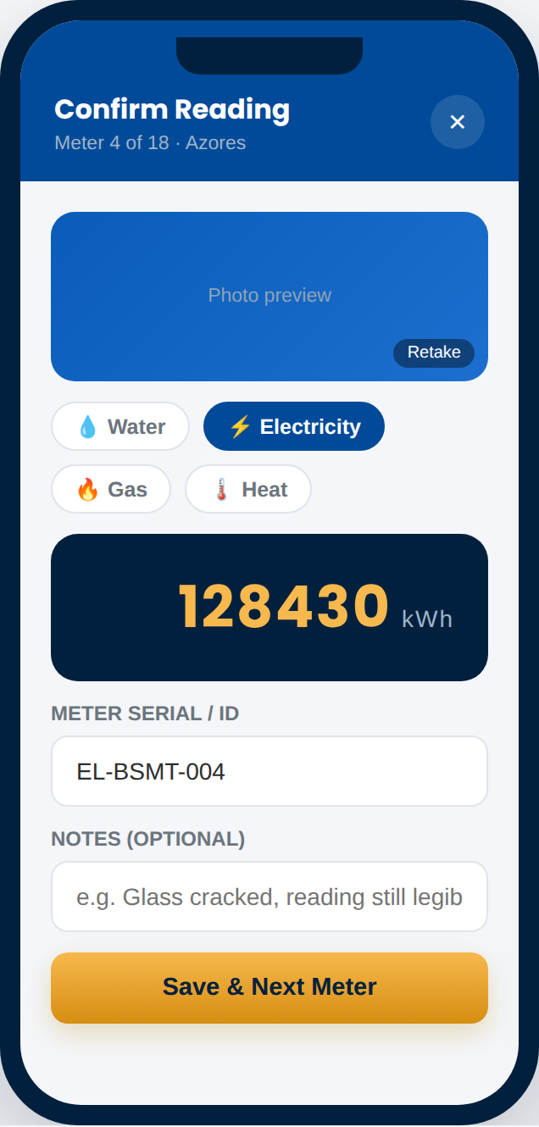
F
Mobile app
Select. Capture. Confirm. Repeat.
The core loop: pick a building, then move through every meter progressively and consecutively — nothing skipped, nothing double-counted.
Fuzio MeterCapture — Concept Pitch
5
Select a building
Progressive checklist
Guided capture
Label & confirm reading

Slide 6




F
Mobile app
Built for gloved hands and patchy signal
Progressive, consecutive capture
Works fully offline
A live checklist keeps operators on order — nothing skipped, nothing double-counted.
Readings and photos queue on-device and sync automatically once back in signal.
Photo-linked readings
Labeling at the point of capture
Every number entered is tied to the exact photo it was read from — no orphaned data.
Meter type, serial and location are tagged in the moment, not reconstructed later.
Session history
Tutorial, always available
Past sessions and their sync status are always visible, per building.
Onboarding isn't a one-time thing — operators can replay it any time from Settings.
Fuzio MeterCapture — Concept Pitch
6

Slide 7
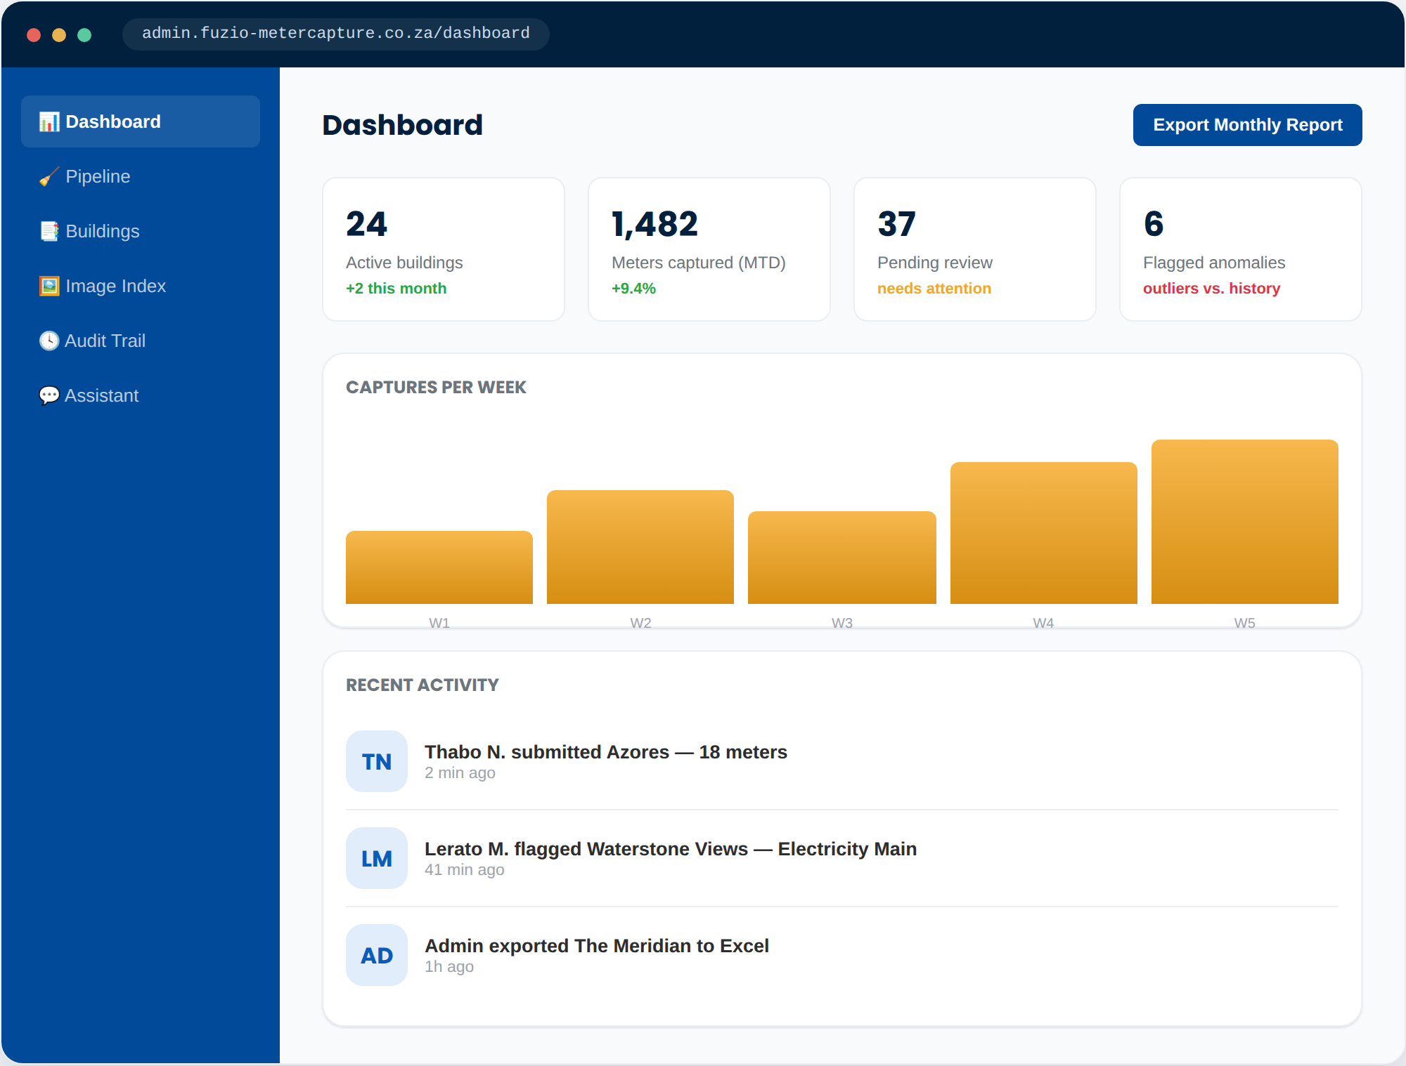
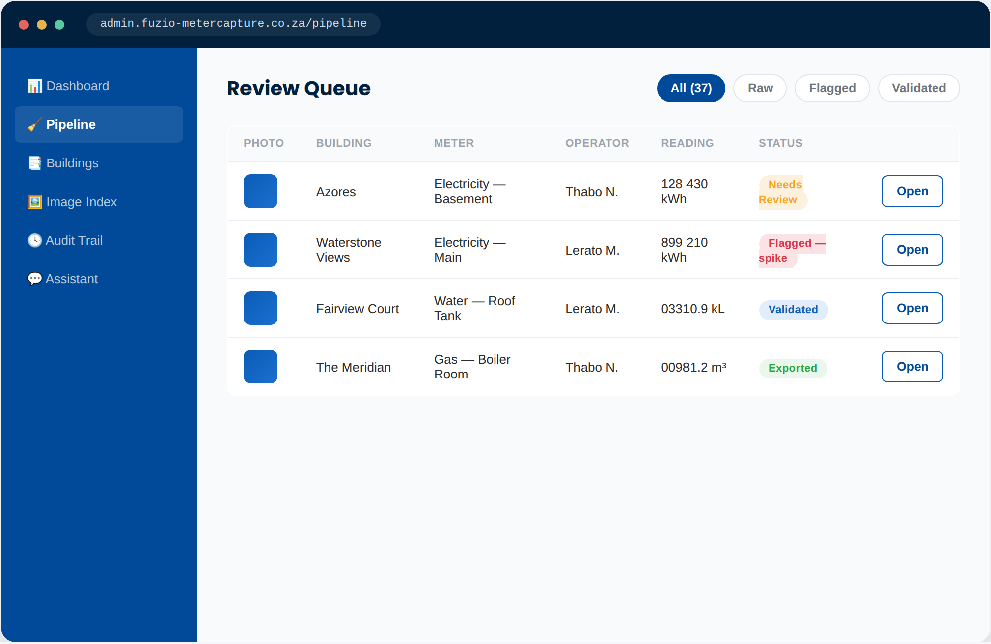
F
Admin portal
Everything captured flows into one back office
Portfolio health at a glance, and a cleaning queue before anything reaches the official record.
Review queue — raw → needs review → validated → exported
Dashboard — portfolio-wide health, anomalies surfaced up front
Fuzio MeterCapture — Concept Pitch
7

Slide 8
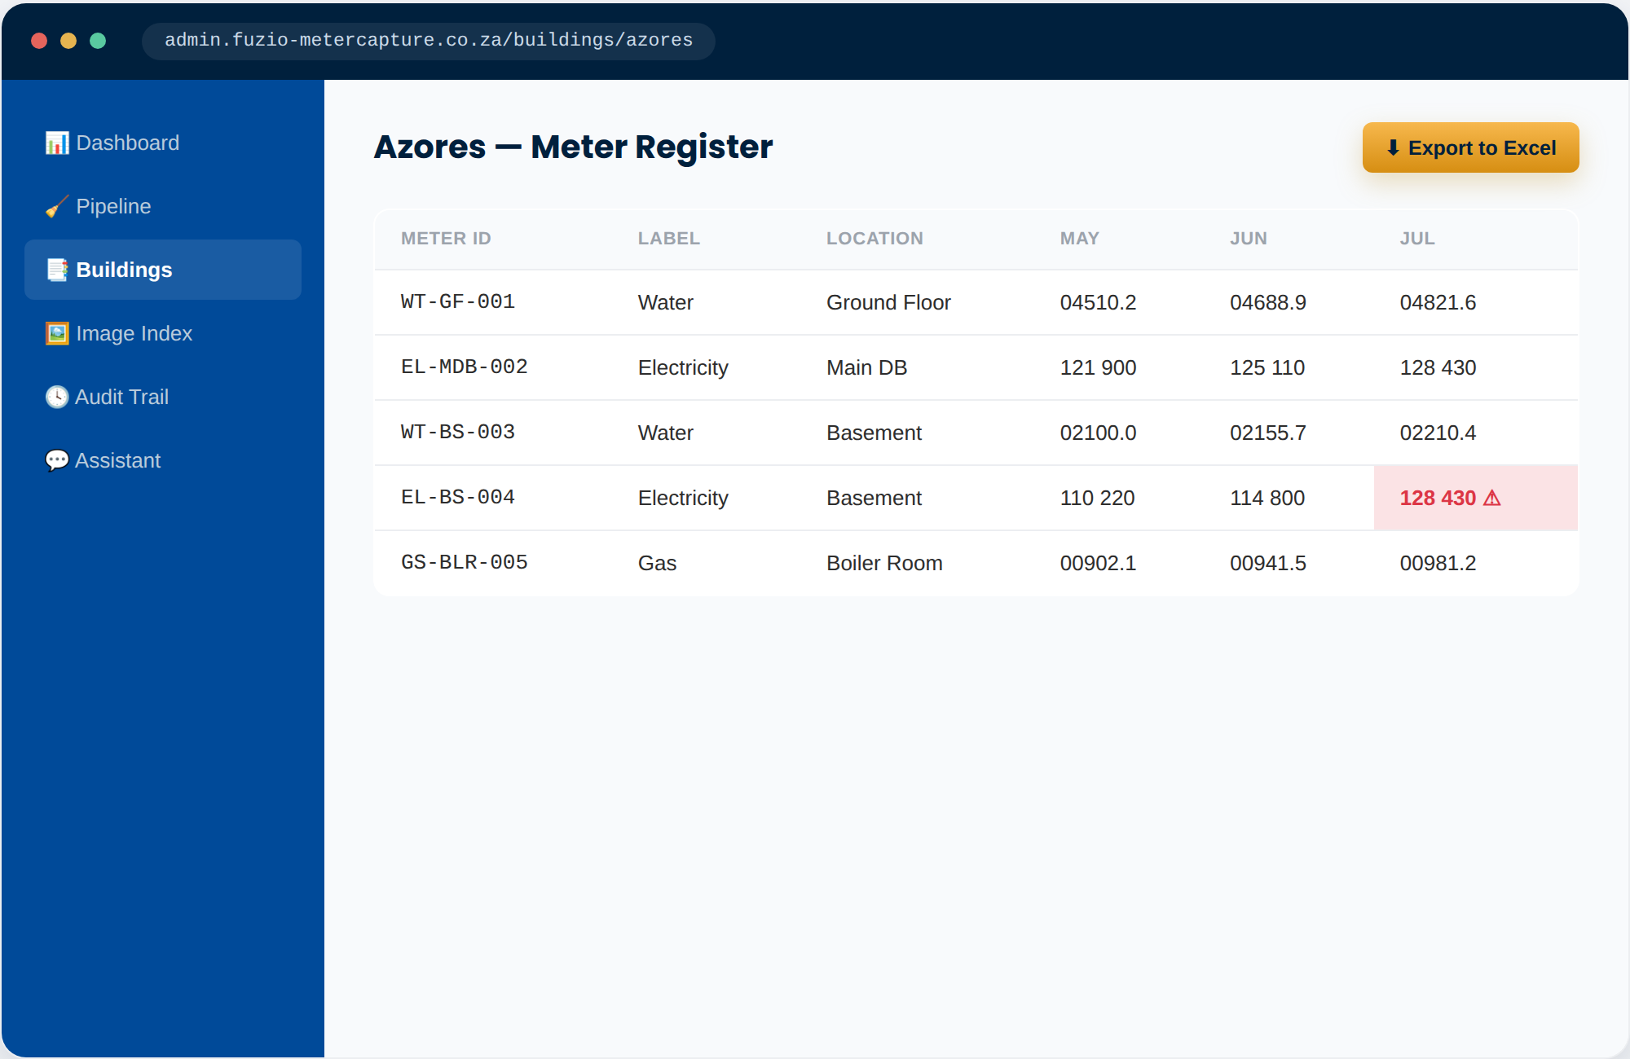
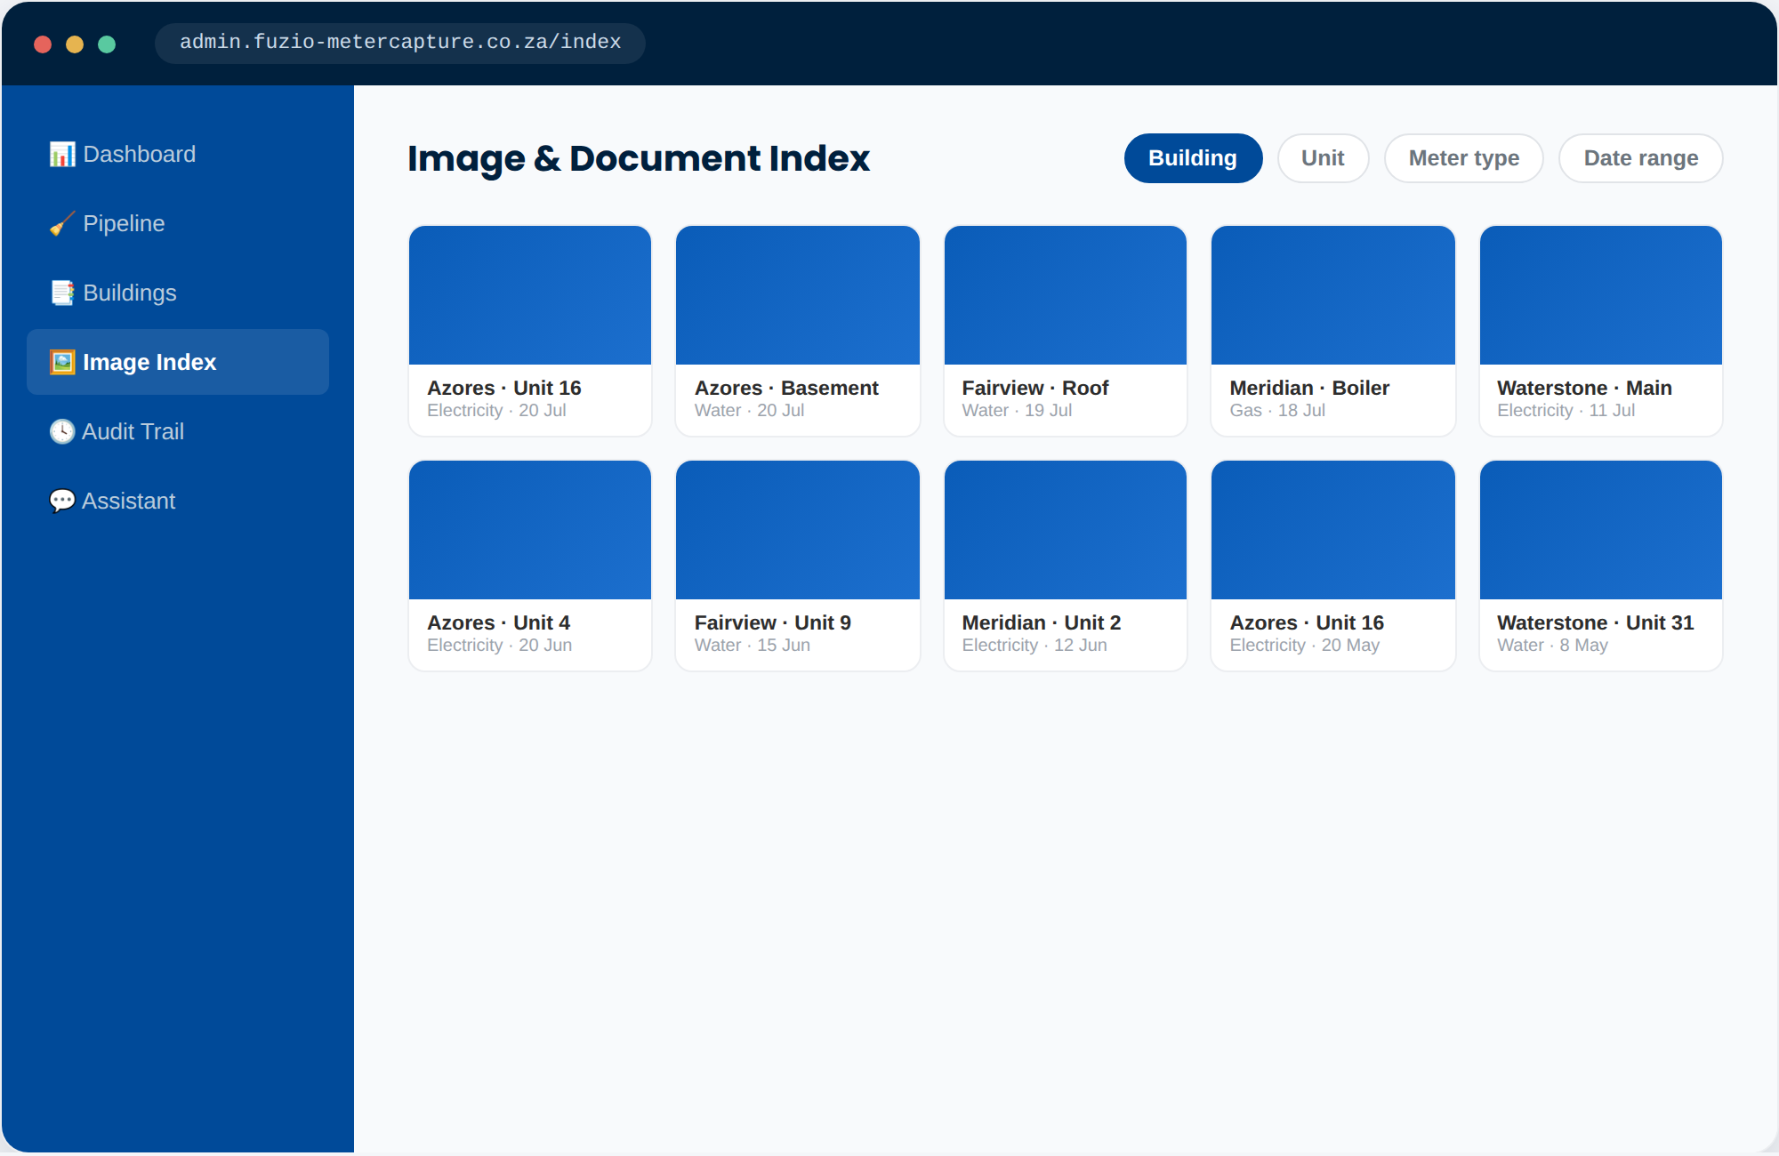
F
Admin portal
A clean register, and every photo indexed
Validated readings land in a per-building Excel register; every photo is tagged and searchable by building, unit, meter type and date.
Per-building spreadsheet view — anomalies highlighted before export
Indexed photo archive — filter by building, unit, meter type, date
Fuzio MeterCapture — Concept Pitch
8

Slide 9
F
Admin portal
Nothing reaches the register unchecked
A defined pipeline is exactly how we learn the cleaning rules the current paper-and-spreadsheet process is missing today.
Raw
Needs Review
Validated
Exported
Captured in the field — photo, reading, label, timestamp, operator.
Auto-flagged when a reading jumps implausibly vs. last month.
Confirmed by an admin against the photo — or corrected.
Written into the building's Excel register and the photo index.
Fuzio MeterCapture — Concept Pitch
9

Slide 10
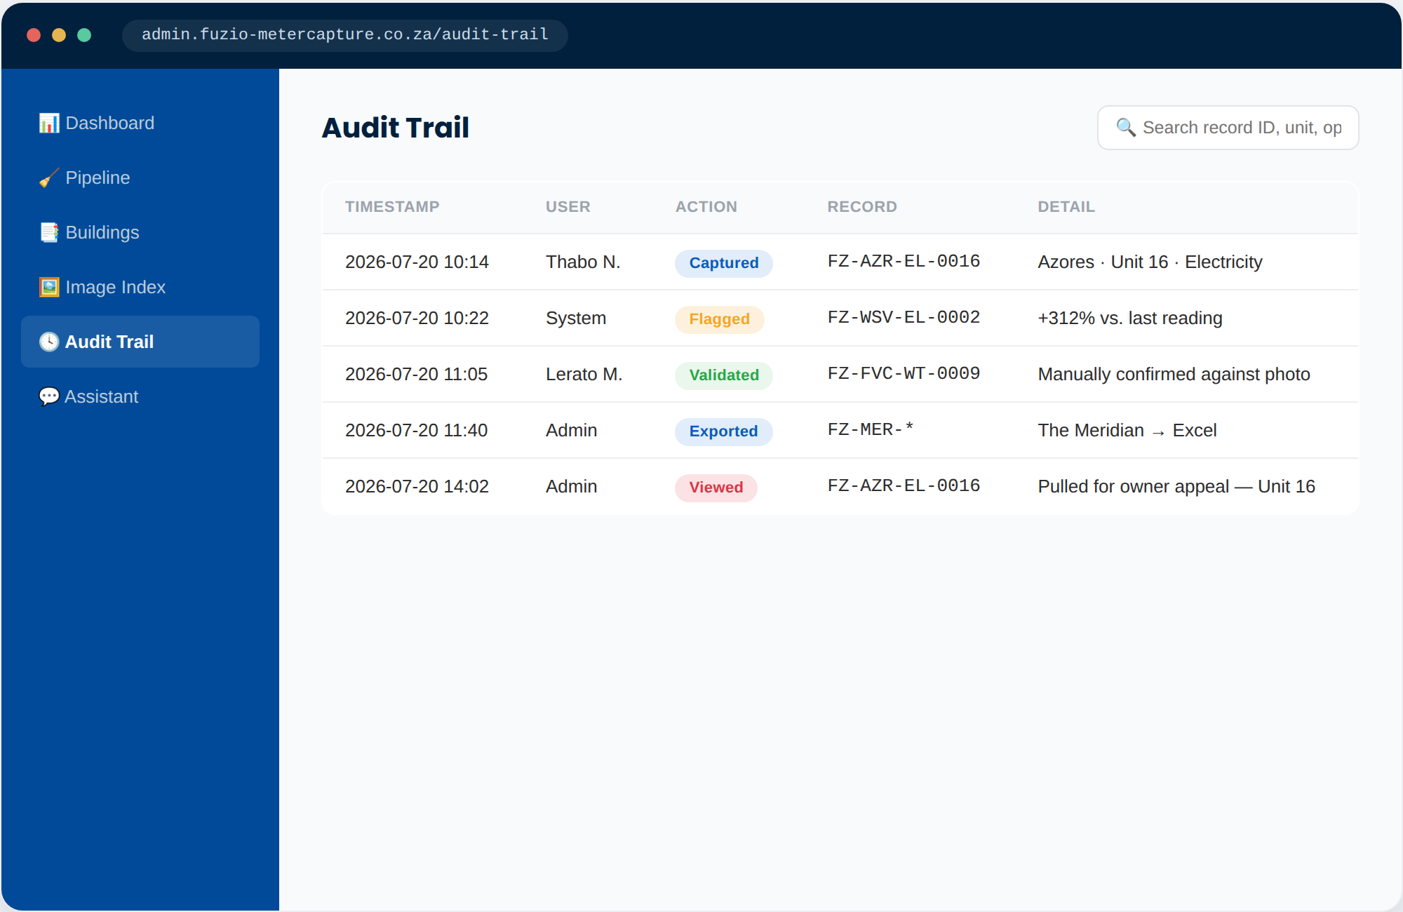

F
Admin portal
An audit trail behind every reading
Every capture, edit, flag, view and export is logged against a record ID — who did what, and when.
Defensible against owner disputes
A full chain of custody from photo to export, ready the moment an appeal comes in.
Searchable by record, unit or operator
Find any reading's history in seconds instead of a manual folder search.
Compliance-ready by default
Nothing is deleted or silently overwritten — corrections are logged as new entries.
Fuzio MeterCapture — Concept Pitch
10

Slide 11
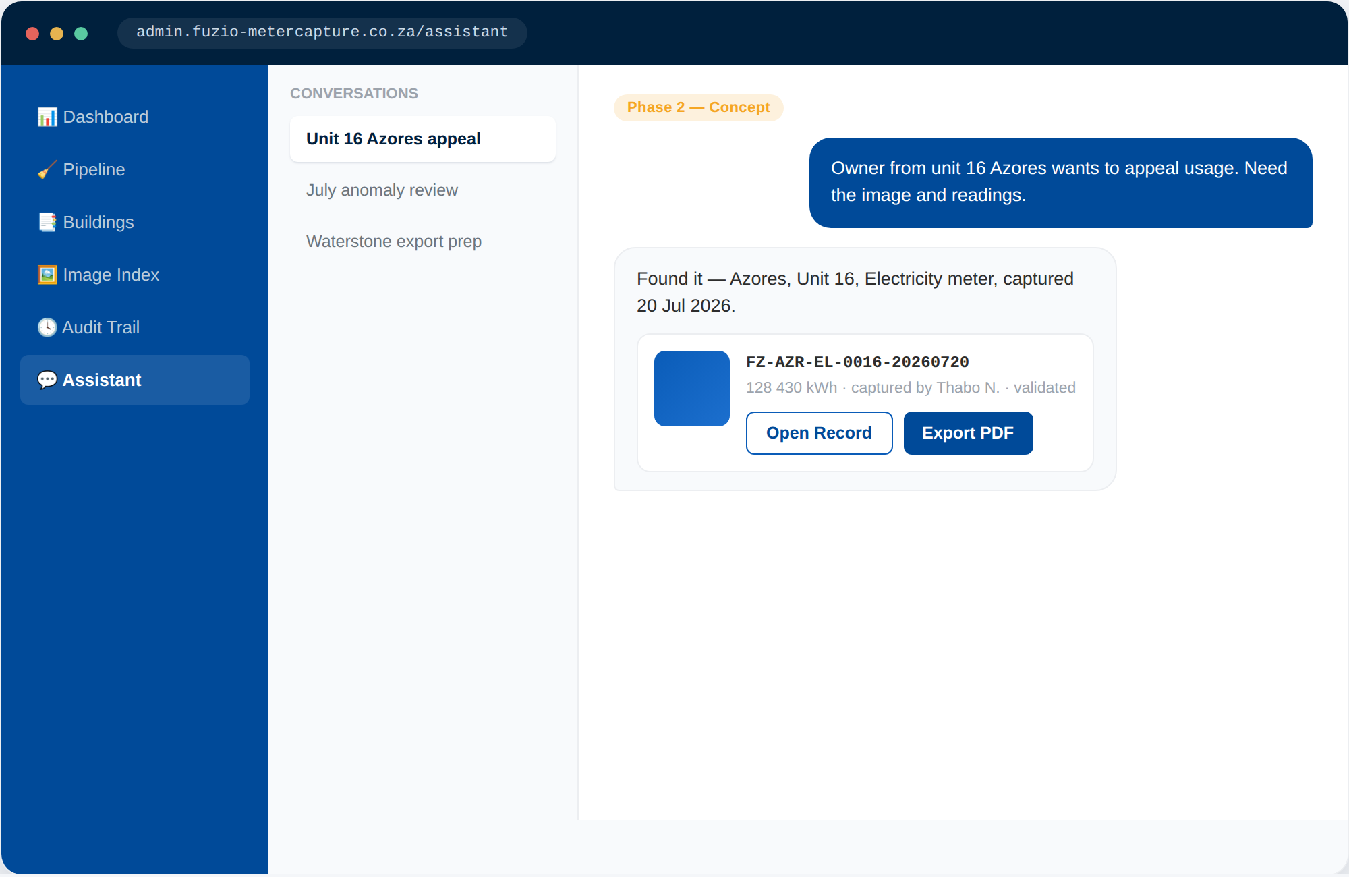
F
Looking ahead
An AI assistant over the same index
PHASE 2 — CONCEPT
Once every reading and photo lives in the indexed audit trail, a natural-language layer on top turns a manual folder search into a single question:
“Owner from unit 16 Azores wants to appeal usage.
Need the image and readings.”
The assistant resolves “unit 16, Azores” to a record ID and surfaces the photo, the reading and the chain of custody instantly.
Fuzio MeterCapture — Concept Pitch
11

Slide 12
F
Roadmap
Projected features, phased in
PHASE 1 — MVP
PHASE 2 — NEXT
PHASE 3 — LATER
Capture & clean
AI over the index
Portfolio intelligence
Mobile app: onboarding, building selection, guided capture
Meter labeling, offline queueing, background sync
Admin: review pipeline, per-building Excel export
Indexed photo archive + full audit trail
Natural-language search across readings and photos
Instant owner-dispute packets (photo + reading + history)
Anomaly explanations in plain language
PDF export for owner correspondence
Usage trend alerts across buildings
Operator route & scheduling optimisation
Direct integration with billing / levy systems
Multi-operator roles & permissions
Fuzio MeterCapture — Concept Pitch
12

Slide 13


F
Next steps
What we need to move from concept to build
Confirm the logo file
Confirm the app template & building list
Brand colors are already wired in from the Staff Hub palette — a vector logo (SVG/PNG) is the last brand asset to drop in.
The starting template, the building/client list, and notes on sites without an on-site operator.
Historical reading spreadsheets
Sign-off to build Phase 1
Past readings and meter labels per building, to define the cleaning rules the pipeline should apply.
Green light to move from this mockup into a working mobile app + admin pipeline.
Fuzio MeterCapture — Concept Pitch
13

Slide 14
F
FUZIO PROPERTIES
Thank you
Let's talk through the mockups, and what it takes to get Phase 1 built.
Nate · warriorgen.2025@gmail.com

